Slide 1
Polling vs. Interrupts
Christopher Mar

Slide 2
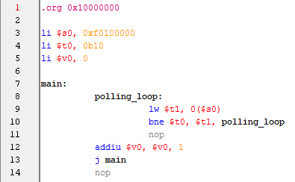
Polling
A loop that is exited when a condition is met
Typically a while loop

Slide 3
Polling
Advantages
Disadvantages
Simple to Implement
Easy to debug
Step through waiting to exit a loop
Program cannot do anything else while polling
Busy wait loop
Not as big of a problem for Project 2 since we have nothing to do until we get all characters

Slide 4
Interrupt
Signal to the processor that something needs to be attended to

Slide 5
Interrupts Terms
Interrupt Service Routine (ISR)
AKA Interrupt handler
Section of code that is run when an interrupt occurs
Interrupt Vector ($iv)
Register that contains the address to jump to

Slide 6
Interrupts Terms
Interrupt Return Address ($ir)
Register that contains the address of the instruction following the last executed instruction before the interrupt
Used to determine where to jump to after the interrupt has been handled by ISR

Slide 7
Using PLP Interrupts
Interrupt Controller
Mask (0xf0700000)
Set bits to enable specific devices to cause interrupts
Status (0xf0700004)
Indicates which device(s) triggered an interrupt

Slide 8
Interrupt Process
Program Instructions
Jump to address in $iv
$ir set to next instruction
$iv
Interrupt Occurs
ISR
$ir
Jump to $ir

Slide 9
Interrupts
Advantages
Disadvantages
Only handles I/O when ready
Instructions are not executed sequentially
Unexpected register changes
An ISR doesn’t know what was happening when it was jumped to
Can be harder to debug

Slide 10
The Choice is Yours

